Slide 1
Estimation And Prediction Of Patient Length Of Stay
Group14：Ya Wang, Yu Qing, Suyuan Wang, Yile Zhu

Slide 2
1. Background 2. Methodology 3. Results 4. Improvements

Slide 3
Background

Slide 4

Background
A crucial metric in healthcare management, length of stay (LOS) has a big influence on hospital resource usage and operational effectiveness in addition to patient outcomes. How to reduce the length of stay while maintaining patient health has become the main focus of attention in recent years due to rising healthcare expenditures and a growth in the number of patients.
In order to maximize the distribution of healthcare resources and raise the general effectiveness of healthcare services, an increasing amount of research is focused on how to employ statistical modeling and machine learning techniques to precisely forecast the duration of hospital stays for patients.

Slide 5
Background
In the related literature, traditional methods include linear regression models, decision trees, etc., which estimate the length of hospital stay by analysing basic information about the patient (e.g., age, gender, and type of admission) and treatment information (e.g., severity of the disease, and mode of diagnosis and treatment).
For example
Professor Xie et. (2020) in their study analysed the effect of different factors on the length of hospital stay using multivariate regression models and concluded that the age of the patient, the reason for admission and the cost of medical care were the main factors affecting the length of hospital stay.
In another study conducted by Chen et al. (2019), machine learning models such as random forest and neural network were used for prediction and achieved high accuracy, indicating that machine learning has good prospects for application in this field.

Slide 6
Methodology

Slide 7
Methodology
1.Data Processing
2.Analytical modeling
3. Model Evaluation
TABLE 1 FEATURES IN THE DATASET
A sample of New York State Department of Health data and a data dictionary were sought for this study.
There are 28,109 pieces of data containing twenty-three dependent variables, including continuous, discrete, and categorical dependent variables.
Hospital.Service.Area | Age.Group | Gender
Race | Ethnicity | Length.of.Stay
Type.of.Admission | Patient.Disposition | Discharge.Year
CCSR.Diagnosis.Code | CCSR.Diagnosis.Description | APR.DRG.Code
APR.DRG.Description | APR.Severity.of.Illness.Code | APR.Severity.of.Illness.Description
APR.Risk.of.Mortality | APR.Medical.Surgical.Description | Payment.Typology.1
Payment.Typology.2 | Payment.Typology.3 | Emergency.Department.Indicator
Total.Charges | Total.Costs

Slide 8
Methodology
1. Data processing / Feature Engineering
a) Dealing with missing data: analysing missing values and filling in missing data using appropriate methods
b) One-hot coding: Convert categorical variables into binary variables for regression models.
c) Logarithmic transformation: Logarithmic transformation of continuous variables to ensure that the data is suitable for model modelling.
2. Analytical modeling
a) Linear Regression: Use stepwise regression to select important variables and assess multicollinearity using VIF.
b) CART: Build a classification and regression tree model to capture non-linear relationships.
3.Model Evaluation:
1. 70-30 Train-Test Split: The dataset will be split into 70% for training and 30% for testing, ensuring model generalization and reducing overfitting.
2. Evaluation Metrics:
a) RMSE: Measures the difference between predicted and actual values; lower RMSE indicates better accuracy.
b) R²: Assesses the model's goodness of fit; higher R² indicates a better explanation of data variability.
3. Model Comparison: Compare linear regression and CART models to determine which better captures non-linear relationships and complex interactions.

Slide 9
Results

Slide 10
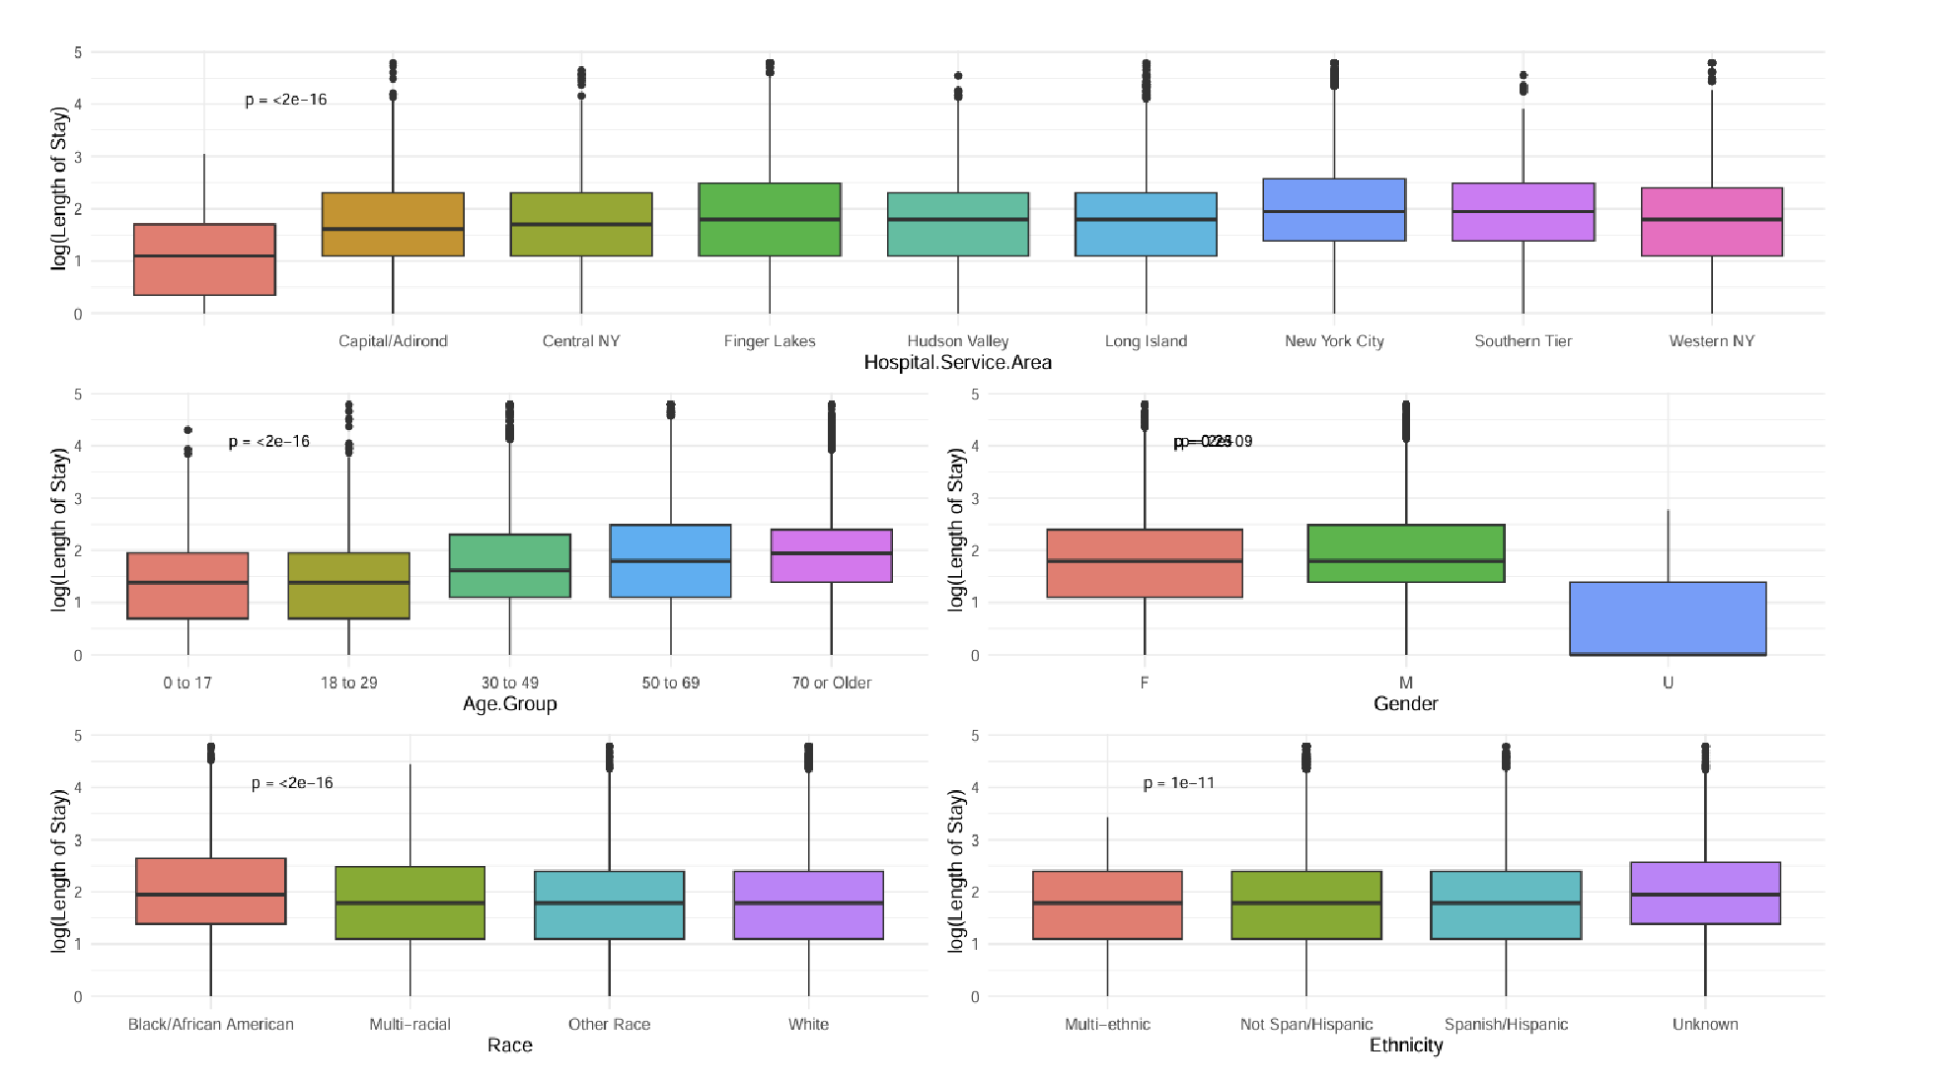
Results
Finding 1：Relationship between demographics and length of stay
1.Hospital.Service.Area, it can be seen that patients in New York City, Southern Tier have longer Length of Stay relative to other regions.
2.The older the patient, the longer the Length of Stay.
3.Male patients have a longer Length of Stay than female patients.
4.Length of Stay is longer for patients of Black/African American race.

Slide 11
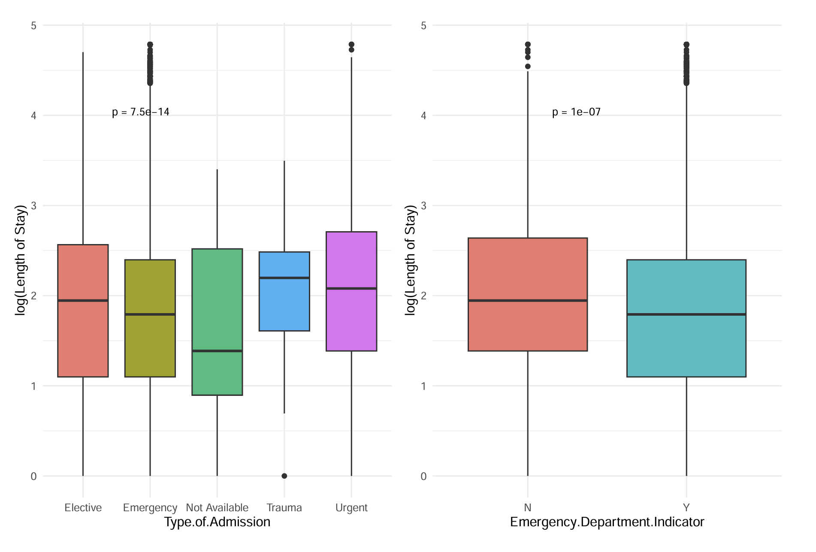
Results
Finding 2：Relationship between admission information and length of stay
- Non-emergency admissions may require multiple treatments or recovery from surgery, and these processes may result in additional hospital days. In contrast, emergency patients, although sicker, may have relatively shorter hospital stays due to more effective emergency management and tighter treatment protocols. Second, non-emergency patients may have more stringent discharge criteria, and hospitals may take longer to ensure that the patient recovers and stabilises, which in turn may affect the median number of hospital days.
- Trauma patients have a longer median length of stay compared to other types of hospitalisation. Trauma patients are usually admitted as a result of an accident or severe trauma, and these patients tend to have more complex conditions that may require multiple tests, treatments, and surgeries, which in turn increase the length of stay.

Slide 12
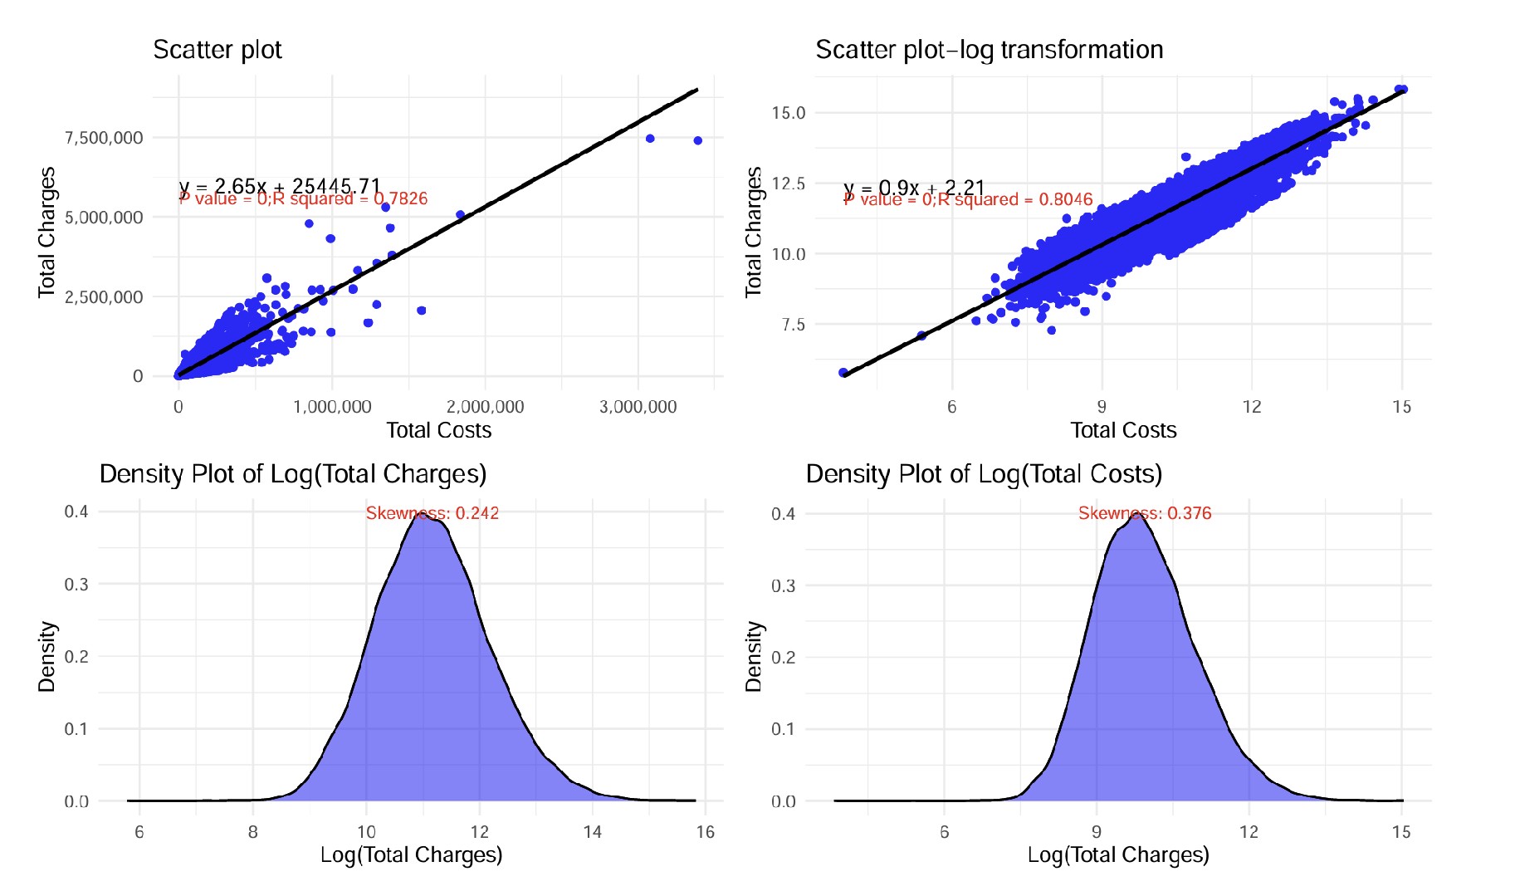
Results
Finding 3：Linear relationship between costs and fees
By building a linear regression model after logarithmic transformation of the relationship between Total Charges for hospitalization (Total Charges) and Total Costs, we observed that the two showed a significant linear relationship, and each parameter in the model had a very high level of significance (p < 2e-16), which demonstrated the validity and reliability of the model; the value of the multiple R2 is 0.8046, indicating that about 80.46% of the total cost variation can be explained by the total cost variation.
The skewness values of Total Charges and Total Costs (0.242 and 0.376, respectively) indicate that the distribution is close to normal and the data distribution is more concentrated.

Slide 13
Improvements

Slide 14
Improvements
We will make the following adjustments and improvements in our next endeavours:
1. Random forests were added to study hospitalisation time prediction to help --capture complex relationships in the data, especially non-linear relationships and interactions between variables.
2. Cross-validation and model selection
Add a cross-validation step to evaluate the performance of different models using k-fold cross-validation on the training set and select the best performing model for test set prediction.

Slide 15
Improvements
Suggest improvements.
1. Data processing and cleaning
• In-depth missing value filling
– Currently using plurality to fill in some of the missing values, statistical modeling (e.g., k-nearest-neighbor filling) or machine-learning predictions could be explored to fill in missing data more accurately to reduce the bias introduced by the filling.
• Outlier detection
– Perform outlier detection on numerical variables, such as the IQR method or the z-score method, to eliminate extreme values or fill in using the median to reduce the negative impact of outliers on model training.
2. Feature Engineering
•. Data normalization/standardization
– For some continuous variables, consider performing normalization after transformation to ensure that the data is evenly distributed and to reduce the effects of scale differences.

Slide 16
Thank You!

